Slide 1
Vena Excelerate =SUM(it) 2022
Evolving your business relationships with change management methods
Notes:
Vennnnaaa
Not Veeeena
Welcome to this Venna Excelerate Summit session ‘Evolving your business relationships with CM methods’

Slide 2
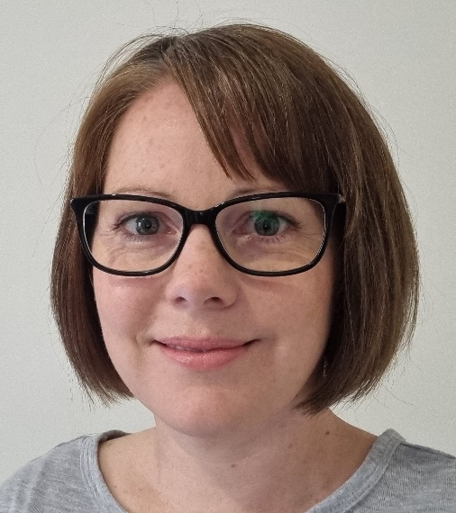
“
I focus on the individual experience
”
15+ YEARS
10+ YEARS
STRONG
Many, many
My Experience
of Working with workplace technology and change
Relationship with Microsoft Product Groups
Focused on Microsoft Office 365
customers
@MeganStrant
MeganStrant.com
Small Business
Mid-Market & Enterprise
Education
(K-12 & Universities)
Government (Local, State, Federal)
Multi-Nationals
Financial, Legal, & Other Regulated Industries
Notes:
My name is Megan Strant, I am a consultant focused on organisational learning and change strategy with majority of work in M365 for 10 years, along with some SAP, SaaS.
In a recent count I reviewed 80+ projects over 10 years. These are across university, nfp, private sector, insurance, health, finance.
My educational background – psychology, org change, role certs like Prince2, training, and experience as a technical PM. As a person – I am passionate about the experience of people in the workplace, along with D&I, relationships we have with each other, how we use technology and our journey in the workplace or with that technology
Also, you may have noticed my accent – I am Australian. This also means I may use some words that are different, or the English/ Australian spelling in my slides.
If something stands out that really confuses you, post a question or follow up with me in the portal.
Before we dive further into the session, I want to talk a bit more about the types of projects I work on to give you more of an idea of the work I do.

Slide 3
Focus areas
Microsoft 365 Migrations
SaaS Implementations
Voice/ Calling
Intune
MFA & MDM
Modern Ways of Working
Notes:
The work I deliver is across the entire platform and as mentioned very much in Microsoft 365.
You can see here I work with platform changes, implementations, and specific calling or apps. I also work with security projects, including how an organisation manages devices, and helping develop ways of working to drive change and enhancements.
I work on a combination of projects vs BAU
The projects may be a specific implementation, an upgrade, or major change.
As for BAU, by this I mean engaging with an organisation to drive further understanding of technology, improve ways of working, productivity and just generally help their employees learn, or drive new processes.
With this I work on reinforcing behaviour.
My longer-term engagements have a strong focus on relationships with employees and senior leaders. There are many key stakeholders – from decision makers, to employees. I work across all areas, at times educating on my role, goals, how it all aligns with company vision and how I’d like to partner with those stakeholders. These are all really important to the success of my role or engagement.
I imagine all this detail is similar with many people on this call – being a SME, driving a specific area, trying to get people to understand your content, maybe data, at times you need buy-in and to take them on a journey.
With all of this in mind, this is what inspired me to create the session today.

Slide 4
Session outline
Change theory and models
The Learning Pit
Change Agents
Key Change Management templates
Notes:
While you may be aware of what CM is, and how it can help drive project or success with changes in an organisation, today I want to briefly show you some of the variation between models and theories to help you think about how it fits into your role or can support your business relationships.
For many of us, relationships are key to the success of our role.
We will briefly explore some of the psych theory crucial to CM, some key models and then with this the Learning Pit. All of this I feel can really help you understand more about people, their experience through change – be it a specific project or ongoing work.
I will talk about your role as a change agent in this and then present some templates I use as part of my own work that I feel could be really useful for a more structure approach to your own work and evolving your relationships.
These templates will be provided to you after the session.
Let’s do this!

Slide 5
Change Theory vs Models
Psychological theory
Bridges Transition Theory
Kubler-Ross Change Curve
Nudge Theory
Change Models
Lewin’s Change Model
McKinsey’s 7-S Model
ADKAR
Notes:
Firstly, change theory vs change models. What am I talking about!
And why is this relevant.
In the space of CM, there are many thoeries. A few I reference or leverage in my role are…
In additional to the psych theory, are models or frameworks build for the structure around guiding people or implementing change.
Some key stand out models are….
Let's review these.

Slide 6
Change Theory
Notes:
Let’s take a look at some of the more psychological theory utilised in change management.

Slide 7
Bridges Transition Theory
Notes:
psychological thoeries help you consider the journey of people when they go through change in the organisation.
Bridges Transition Theory proposes that for successful change to occur, employees must be brought on a journey guided through three stages of transition (as you can see in the image)
The model focuses on guiding employees through the reactions and emotions they will face when dealing with change.
Strong also in academia
Shows employees go through a psychological journey with transitions
To drive successful business change, we need to take people through that journey
This can be simple yet powerful, however it is not a model used for analysis
The focus here is on humans, and feelings.
Remember CM is very much about people, so it is useful to review these theories as a reminder of how people react or are impacted, especially if your role is very black and white, data driven etc.

Slide 8
Kubler-Ross Change Curve
Notes:
Another psychological theory is the K-R CC
This model allows you to focus on and deal with the emotional responses to change.
Based on 5 stages of grief that Elisabeth Kubler-Ross describes in her book – On Death & Dying.
Her research with death and dying helped show that major transitions in workplaces can follow a similar pattern and be deep psychological journeys for people.
When you go through something major you may notice you may go through a journey and this process, and remember people don't go through the model at the same time or in same order
This has been around for a really long time but still very relevant
Anticipates stress and resistance problems in advance
With a focus on supporting employees
With this theory - Needs to be supplemented with another approach with technical side of change, a model to structure the activities and program of work
Focuses on indiv not collective journey

Slide 9
Satir Change Management Model
Notes:
Similar to Kubler- Ross, Satir analysed the journey people go through except it applies the progression through the 5 stages of grief to a general model of performance during change – helping predict and track the effect of change on overall performance.
Five stages: Late status quo, resistance, chaos, integration, new status quo
Built off the Kubler-Ross, took a more clinical view
What does the emotional process mean in terms of productivity
Different curve but has similarities
It illustrates that managing change needs to have less of a productivity drop as a goal
Calls our the productivity dip - the dotted line
Simplified K-R, emotional journey but focus on reducing the dip and minimising productivity loss with good CM
However again is a theory, but doesn't show detail on how to manage employees through the process

Slide 10
Nudge Theory
Notes:
Finally, I have to mention Nudge Theory. It is just that – another theory.
There are no set CM steps or model, or framework, but a mindset to be applied to frame change in a positive manner.
Instead of telling your employees or colleagues what to do and how to change, you allow them to choose to change by giving them ‘nudges’.
There are basic principles to follow when nudge change – in the visual.
A theory not major model
Mindset type approach - instead of telling people, give them nudges and nudge changes
Employee centric view
Remember, this is about people and understanding them, not a framework to follow. But still has value in what you or I are trying to achieve.

Slide 11
Change Management Models
Notes:
How do models differ, what are some and how could they help.
Even if you are not a change manager.

Slide 12
Lewin’s Change Model
Notes:
Firstly, Lewin’s Change Model.
Lewin describes 3 stages of CM: unfreeze, make changes, and refreeze
This is a model I refer to a lot. The idea of having to ‘unfreeze’ people I find really resonates. Maybe you can think of some departments or individuals in your workplace that could do with ‘unfreezing’ their ways.
A key issue is - this model assumes the future state is locked, which doesn’t really fit our world these days with ongoing change, so isn’t as relevant as once was.
The model is great for drastic change, forces org to analyse processes and what needs to change, used for process engineering
It can though be difficult and time consuming due to deep analysis required.
Even just thinking about this model can be useful in how you engage or plan.

Slide 13
McKinsey’s 7-S Model
Notes:
Another popular model is Mckinsey’s 7-S Model is great for analysing how coherent your organisation is, and a great model if you NEED to change, but don’t know WHAT to change.
You analyse the 7 aspects and how they effect each other, which enables you to highlight the changes you need to make.
More holistic than most models, talks more to operating model
You really get into the detail of what is going on
Really about how these all impact each other – I love how it review interconnectedness across the areas of an organisation
This model ensures all areas of orgs support each other
It does require a lot of time to carry out effectively
Both Lewin and McKinsey (and to some extent Kotter, but not as much) are much more focused on the process and steps, which hopefully you can see is different from psychological theories.

Slide 14
ADKAR
Notes:
Finally, just one more, ADKAR is the model I hear about the most in consulting and across many organisations, especially Microsoft. the Prosci method.
It is another people focused approach.
The model is a set of 5 goals to reach, which enables change to be effectively planned and enacted on both an individual and organisational level.
ADKAR is well known in most markets
Prosci still considered leading CM framework used around the world
Great for small changes
Idea is that we plan change as taking people on a journey from awareness through to reinforcement
I wouldn’t use ADKAR for a major transformation – it’s not about business process, major restructure, not great when you don't know what you want to change
It is great for the people journey, but not so much about analysis of where we want to head and how to get there
The way ADKAR Focuses on the idea of awareness – reinforcement, relates to psych journey people go through. This is why it is so popular.
Maybe some of this has you thinking about a project or goal in your role and organisation. And how models or theory can support what you are trying to achieve or do to people.

Slide 15
Additional considerations?
Notes:
We can consider the theory to understand how people cope or are impacted, and we can review models to help create a structured approach, or check what needs to be addressed.
Before we progress, I want to present an additional idea that I feel helps me in the workplace when I am considering projects, technology, and relationships.

Slide 16
Notes:
Let’s pause for a moment and look at the Learning Pit.
This is a great tool to visualise a learning journey, and actually used in many schools.
I like to apply this to the workplace, as I think we can all relate.
When we are asked to use new technology, there is definitely that frustration, otherwise known as ‘conscious incompetence’ (in psych theory).
We feel dumb. And we have to push on to keep learning, and head to ‘unconscious competence’ where things become easy and on autopilot. Look at the visual. Deep in the pit people are confused, and its hard work to learn or adopt something new.
Think about a person you work with, meet with, present to, explain things to. Sometimes we have to deal with people who we have thrust into the pit.
They can be struggling, and even defensive. If you can find key skills or ways to help them climb out of the pit, it will build stronger rapport and success.
Sometimes it means your role becomes ‘teacher’.
In your role, you could be explaining data, charts, forecasting, or detail about ledgers. You are the expert on that detail, and people need to understand or trust you.
Supporting them will drive stronger change and results.
If you are trying to evolve your role and achieve business outcomes, you need to take people on that journey (which could mean thrusting them into the pit, and helping them climb out the other side). You may be the only person in the organisation who has visibility over data and you may need to take people on a journey of understanding to build stronger partnerships and get them on board.
I love this visual, combined with theory and models, to really deeply understand people and learning.

Slide 17
Your role supporting the journey of others
Notes:
Pause for a moment and consider what we have explored so far.
While you have a specific role in the business, you have goals, deliverables, structure etc
When it comes to thinking outside your role, and taking on board what we have just reviewed, there is something key to think about. And that is you as an agent of change in your organisation.

Slide 18
Change Agent vs Change Management
Change Agent | Change Management
Anyone in an organisation who is a catalyst or advocate for change. | Structured strategic management approach aiming to implement changes effectively.
Notes:
What is a Change Agent?
They are an advocate or catalyst.
They help the organisation transform by focusing on things like organisational effectiveness, process, improvements and development.
Influences others
Helper
While your role at times might require you to engage with other people in the business, you could be presenting quarterly figures or assessing budgets, your role and relationships can extend beyond some data or reports.
Think back to the learning pit – and how you can be part of taking people on a journey, and helping provide support and guidance to get them out of that pit.
You are supporting, teaching, and perhaps helping people move through a transition. It could be that unfreezing of an old way to a new way. It could be some new software or process.

Slide 19
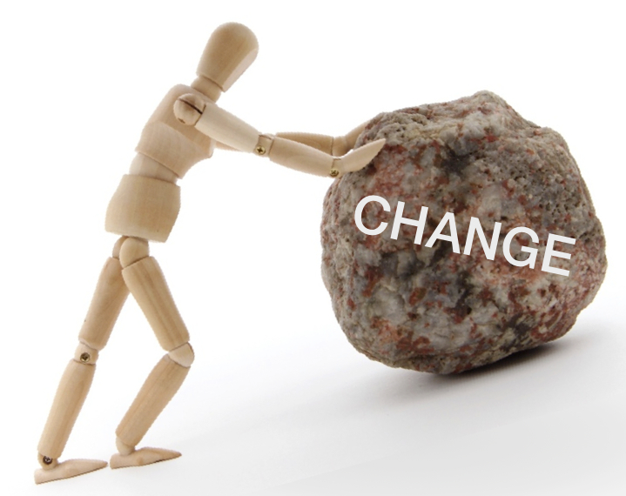
Change Agents
Communicate clearly and promptly the goals, priorities and objectives of change
Promote and support a way of doing
Have open, two-way communication channels
Be able to empathise with people being affected by a change
Notes:
Essentially, you are in a sense an agent of change.
Which can feel at times like you’re in an uphill battle.
You could be driving change or just evolving relationships and their role.
Goals, communication, and empathy is key
Change agents:
Promotes and supports a way of doing – a process, or new structure
Initiates or manages change
Creates a strong sense of identity and purpose
Has a high-performing mindset – you do, you’re here!
Help the road be smooth, not panicked
Focus on ppl in the business and how things affect them

Slide 20
Qualities of a successful Change Agent
Demonstrate flexibility and resilience
Recognising growth opportunity
Striding for results
Leading courageously
Gaining buy-in
Notes:
Focus on people in the business, how things effect them, and the journey they are on
Hopefully these ideas resonate with many of you.

Slide 21
Boosting your business relationships
Unfreezing old ways
Interconnectedness
Awareness and education
Individual journeys
Productivity
You!
Notes:
let’s bring it all together.
The theory, frameworks, models and experience of a person, including them at times being thrust into the learning pit.
I am not trying to make things complex, but help you explore different ideas and concepts that could be useful to take back into your role.
When we think about business relationships, the ideas can all come into play.
Theories and models
Unfreezing
Interconnectiveness – things across the org impact roles, depts and your work may flow onto different areas
ADKAR – awareness, and education, teaching, reinforcing – at times you have to teach about your role and the business journey
The psychological journey of people – at times change means they have to let go of something – it has been compared to grief
Give time for people to response and be carried in the journey – at it isn’t at the same time. And they need nudges.
Impact on productivity –
Finally - You – you are a person on a journey too – it can be hard and at times you want to give up.

Slide 22
Templates to boost your work
Plan
Assess
Teach
Notes:
Now I want to take you further with some templates you can utilise to evolve and expand how you work with others, or how you review and plan yourself.
While some of these templates are for projects with a close or goals, combined with the psych theories and models, some of these activities could apply and help with your stakeholders.
Templates can help use a more structured approach – you don’t need to share, or some detail can help in your engagement with others, some for your own reference.

Slide 23
Plan
Notes:
Planning.
It seems logical, and to some easy.
However, not all of us have a structure, forward planning mindset. Or can be deep in detail and need at times to be pulled up high level to help others come along the journey.
A key template I use in projects that is always appreciated is a Plan on a Page.

Slide 24
What is your overarching goal or strategy?
Technical implementation
Process change
New type of data or reports
Campaign for organisation wide change
Stakeholder learning
Notes:
When considering a plan, It’s not always clear cut.
There may be a technical project, a new process, or minor change. But you should review streams of work and work on how it is perceived by staff.
Also, consider your strategic pillars of the organisation.
Does this change link to one – eg Modern Workplace
What is the WIIFM, the benefit and motivation for people to change.
Think about things like the technical, process, what is changing, what people need to know, why, when etc – and make it visual.

Slide 25
High Level Plan on a Page
Notes:
A plan can be for a project, and there will be other roles in the organisation who build a plan in things like a Project charter, or part of a different process like Prince2, Agile, Lean Six Sigma
CM use POAP, other areas have similar – I always create my own to help my own understanding and to use in my own stakeholder engagement.
Essentially I love having a visual, and find it is something clients and stakeholders respond to.
If you have various components of information or activities, heading towards an end state, or breaking down some information – make it visual!
Here is a snapshot of a POAP from a previous project, along with the next slide.
For Microsoft Teams, at some level it is seen as being ‘turned on’. Enabled for calling and meetings. At times the deeper teamwork and collaboration is progressed later.
Or, there are phases of training as you can see in the middle section.
Think about the timeline you want to present, any key phases, deliverables, dates and make it visual for an impact. People love colourful images to help connect detail together.
You can see this one is in weeks (this is the first template I am providing), while the next example is many months.

Slide 26
Detailed Program Plan
Notes:
This is a more detailed program of work.
Rather than high level phases, there are key activities and dates, or milestones.
The template I am providing is the first high level plan, however this image gives you an idea of how you can make things more detailed depending on your audience and needs.
Dynamic CRM implementation brings with it deep review of processes, complex training varying across roles, UAT, detailed requirements etc.

Slide 27
Assess
Notes:
Along with planning, a key thing across many models is assessment. You assess stakeholders, assess feedback, assess impact.
While there are a few things you can assess, what I want to focus on is the impact of a change, and your stakeholders.
Also consider getting feedback as you take people on a journey, but we wont jump into this today.
Let’s talk impacts.

Slide 28
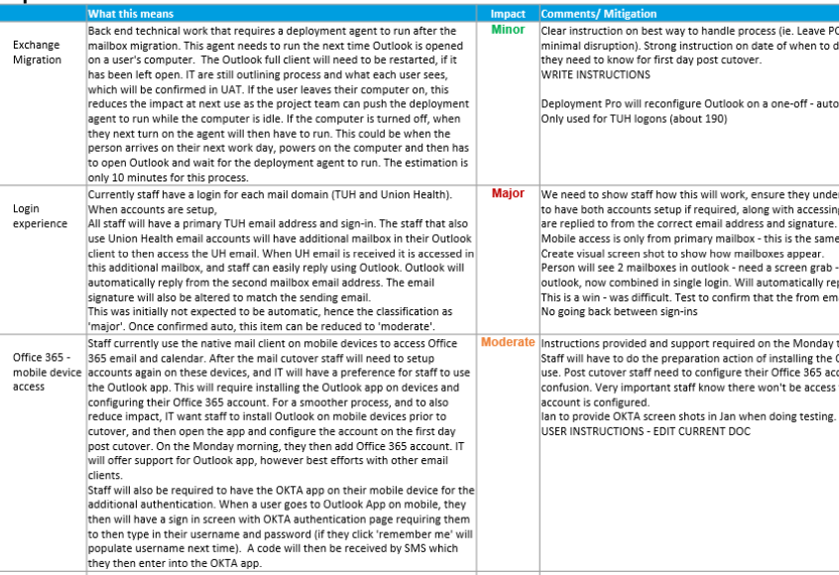
Macro Impact Assessment
Notes:
It is often crucial to assess impact. This could be of a change, or from data you are presenting. It could be the impact of forecasting or a strategy, or a project.
I like to deliver specifically either macro or micro
Macro is a high level view, a quicker snap shot. Its usually what I do before I dig deep. It may just be a starting place, or all that is required.
Some projects, I do my own macro IA to help understand what is going on. Other times there is a long workshop to explore the detailed IA.
For some Microsoft projects, a lighter approach suits that still addresses the detail. Take time to sense check to know what will impact productivity and possibly cause frustration, or impact people in any way.
Talk through the live doc….

Slide 29
Micro/ Detailed Impact Assessment
Notes:
This is a common kind of template used for a Micro IA, or DIA, and it is the second template I am supplying.
You can see there is a lot of topics to cover – describing the change, the future state, processes, jobs or people impacted, solutions, mitigation.
Again, if you are trying to push a change, educate people on something or deliver a project, this detail may be worth working through.
It helps you consider the future state, goals and where you’re trying to get to. It can help build shared buy-in and the path you are on.
Reminds you to consider why you are doing it
Check we going I the right direction – does it align with org vision.
When assessing CM for major projects or working with large organisations, I complete this assessment in a very detailed way across departments, user groups and all areas of your technical solution.
Such as, call flows and hardware, Team structure and configuration, security app setup and process.
It is important to have a realistic view of the experience of your people, and the impact from the change.
Be careful the person completing the impact assessment understands the experience of people across role, gender, culture, generation. Are they from the IT team and think its all easy and low key. Are they from the business and being too hyper sensitive and less savvy than the status quo?
Consider a cross section included for this review.
Have a strong template to guide the process. Go through the motions of reviewing each category and also the mitigation to ensure you support your people.
The CIA isn’t presented or sent around. Some stakeholders may want the detail, for others I prepare summary slides. A version of this detail ensures I have considered all areas and thought through how to support people in the change journey.

Slide 30
Stakeholder analysis RACI Matrix
Notes:
For assessing stakeholders, RACI is a global method that may be familiar.
However, not so much a CM method, but across a program or project.
In CM it may have a slightly different purpose….

Slide 31
Stakeholder Analysis
Notes:
A stakeholder analysis table. This is the 3rd template I am providing.
To me this is a living document and for my own reference – or in a project it is a key CM artefact.
I like to track all sorts of things. Their role, the detail they need to be across, along with some of the RACI type detail. I even track things that help with rapport like their football team, key details for getting in contact, preferences. Things to help my relationships.
Also, things that help me prepare for a meeting.
Don’t just turn up to meetings with different stakeholders with the same plan and detail. People differ. (Sue/ Nina example – expressive vs analytical)
Go deep into data and you frustrate people, or too high level and you lose trust. Get to know people and show up with the detail to satisfy them.
After assessment, the next key area is ‘teach’.

Slide 32
Teach
Notes:
We often don’t realise that we play the role of educator or teacher at times.
We may have that Change Agent hat on, advocating a new process, supporting learning of new tech etc.

Slide 33
What is the journey for your stakeholders?
How will you ensure they understand what is going on?
How will they be prepared and on board?
How will you support them ongoing?
Notes:
Learning is a journey – and so are your relationships.
In your role, at times you are teaching – about the goals/ objectives, company strategy, or concepts in your reports, data, what you present.
With your org relationships, are there things they need to learn?
Again, this could be part of a project, a change or just in your role how you drive deeper understanding of your outputs.
One of my favourite visuals is….

Slide 34
Learning Approach
The learning Principles for the Program are:
Awareness
Seed Learning
Formal Training
Embedding
Communication and activities designed to build base familiarisation next phase in the Program.
Content designed to support core concepts and requirements.
Learning to support each product or scenario.
Activities to support ongoing development and behaviour change – moving towards transformed state!
Concepts and content are seeded into relevant program preparatory learning and engagement activities are deployed
Embedding
On the floor and accessible support to increase capability and confidence.
Face-to-face
More formal and interactive learning pathways to ensure the skills are developed and users prepared.
Language and concepts are socialised
Champions and Leaders activate language and concepts.
The journey to transformed state and the drive to becoming more proficient users of the online way of working.
Notes:
Slide from an old role.’
I love that this makes us think about the stages people go through, and that its not just one-off training.
In a project, it’s not about a quick email – comm’s are drafted with a purpose – be it broad context or call to action.
You can think of stages of learning like planting a seed vs deep formal training.
And – what get’s often lost – longer term embedding.
Just like how in my Office 365 projects, the detail is not ‘set and forget’, it can be similar to how you drive education and engage with people to take them through your data and content you produce in your role. Its ongoing – people can always enhance their knowledge and grow ongoing when they engage with you over time.
Think about how you meet with people, and how you try to explain content. You are taking them on a learning journey, and at times its worth breaking down components and using table of the things to understand to really connect with your data so they find it really valuable. This is a great way to evolve your role and how you engage with people.

Slide 35
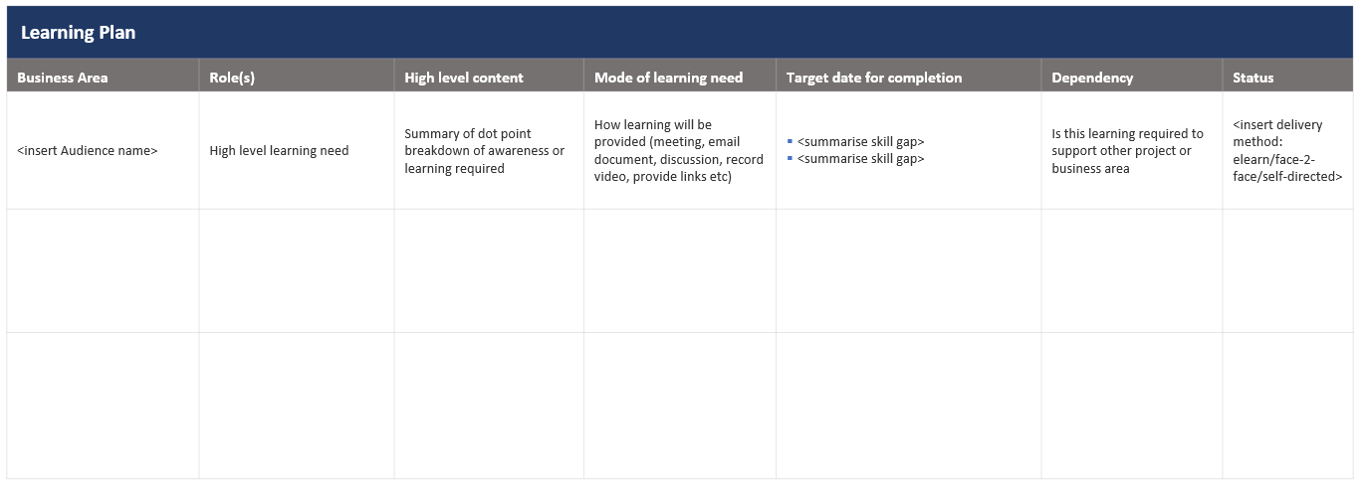
Technical project learning journey
Notes:
The 4th template.
This learning Plan outlines high level learning needs, audience groups and defines the level of detail for these people. You can also use a table like this to make about further information in a separate Learning Needs Analysis across areas of the business.
Maybe some areas understand the detail to a point but you get a feel for some confusion. Make your own log, or share with them some key areas you want to walk them through to support deeper understanding.
I personally don’t share this, it is a reference so I keep track of where I could do more work with people. At times I combine into the stakeholder template.
You don’t need to take on all of these template, and your organisation may already have processes for projects and change. Ponder what could supplement what you do.

Slide 36
Closing thoughts
Take people on a journey
Manage relationships
Be an agent of change
Review your role, goals, relationships
Take a structure approach to provide people with what they need
Notes:
Phew! [time check]
That was a lot to take in.
Try not to over complicate it, break it down for people, and yourself.
Consider - What is the point of what you do, what do you want people to know
What is the value-add to the business
Always think it through and grow your relationships while growing your own role and skills.
Take your questions to the portal. And thanks for attending and taking some time to consider these ideas!

Slide 37
Thank you!
Organisational Change Consultant
meganstrant.com
@MeganStrant

